Slide 1

Programming for Engineers
BEP2073
>> Slide 6.1
>> Function, method and class (Part 2)
Functions as a type, anonymous functions and list comprehensions codes.

Slide 2

Course Learning Outcome
CLO1 | Outline the operational procedure of programming language.
CLO2 | Outline the object-oriented attribute in the programming flow.
CLO3 | Evaluate the program structure on function, branching and condition.
CLO4 | Develop a programming/syntax solution for chemical engineering case study.
CLO5 | Differentiate between solution error and syntax error for complex engineering case study

Slide 3
EXCEPTIONS
An “exception” is usually defined as “something that does not conform to the norm,” and is therefore somewhat rare.
Example
test = [1,2,3]
test[3]
List of exception: IndexError, ValueError, ZeroDivisionError, and more.
Ref: https://www.programiz.com/python-programming/exceptions
Control Flow Mechanism: raise exceptionName(arguments)

Slide 4
TRY-EXCEPT
This code will work just fine, but it will fail if numFailures happens to be zero.
It would have been better to have try-except
x = 1
y = 2
ratio = x/y
print(ratio)
try:
ratio = x/y
print('The ratio is’ + str(ratio))
except ZeroDivisionError as e:
print(‘Error: ’,e)

Slide 5
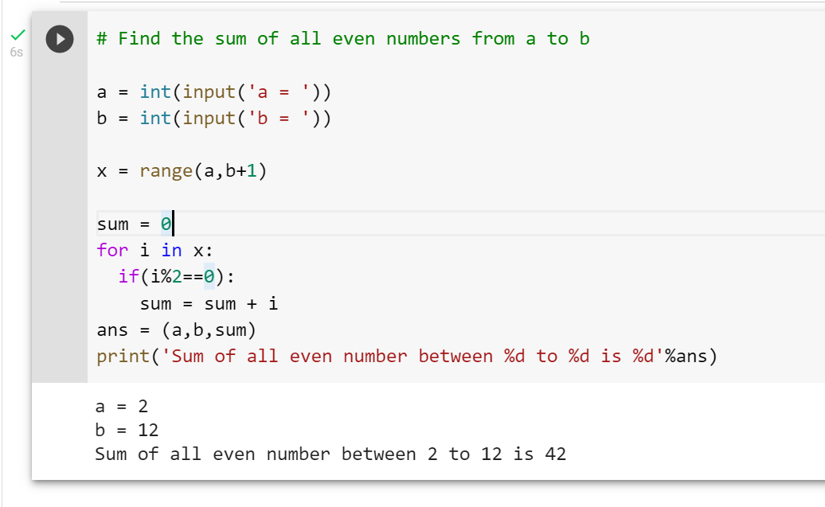

Revision
By using function, class and module,
Write a python program to find the sum of all even numbers from user’s specify range (a, b).
In the program MUST have as follows:
Display the answer use this format
“Sum of all even number between <a> to <b> is <c>”
Allow range for all positive number
For a is less than b

Slide 6







Slide 7



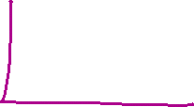




Open-source module
Visualisation
Matplotlib
Data Processing and Modeling
NumPy – Matrix manipulation
Pandas - data structures: "Series" (1D) and "Data Frames“ (2D)
SciPy - linear algebra, optimization, and statistics
Keras - neural networks and modeling
PyTorch - deep learning

Slide 8






Data to Fish
Pandas - I/O API
Powerful Python data analysis toolkit
pandas.read_csv()
return a pandas object.
import pandas as pd
data = pd.read_csv (r'Path\File name.csv')
>> import pandas as pd
>> pd.__version__

Slide 9
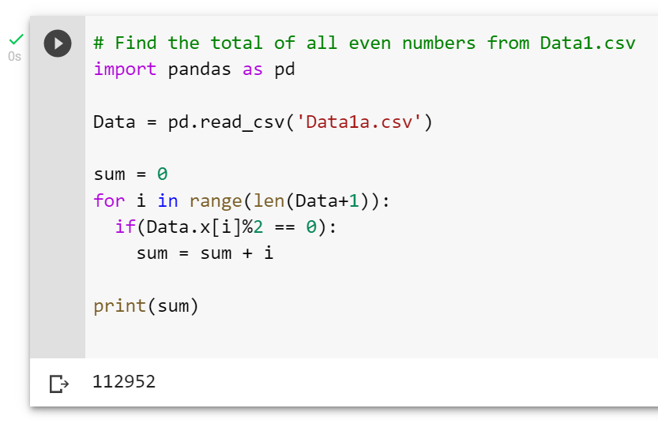

Exercise 1
Load Data1.csv by using pandas and develop a program to determine:
Total odd number
Total even number
Total prime number (Challenge)

Slide 10
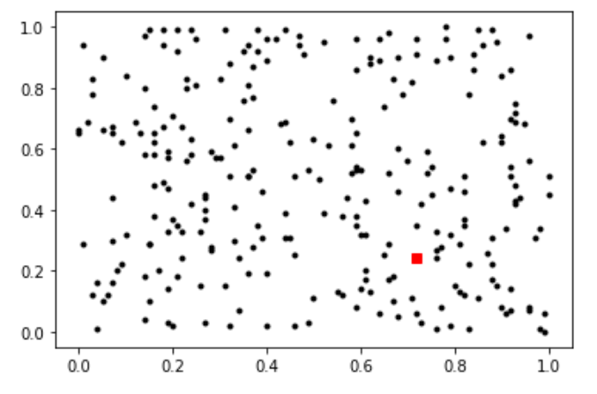
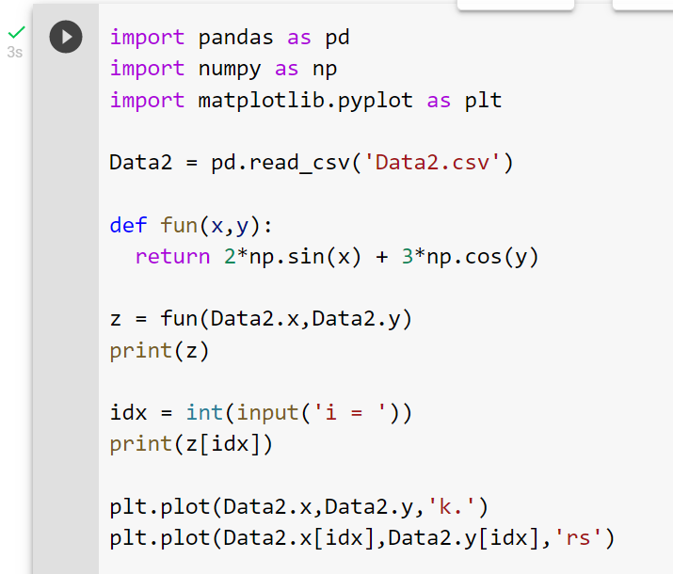
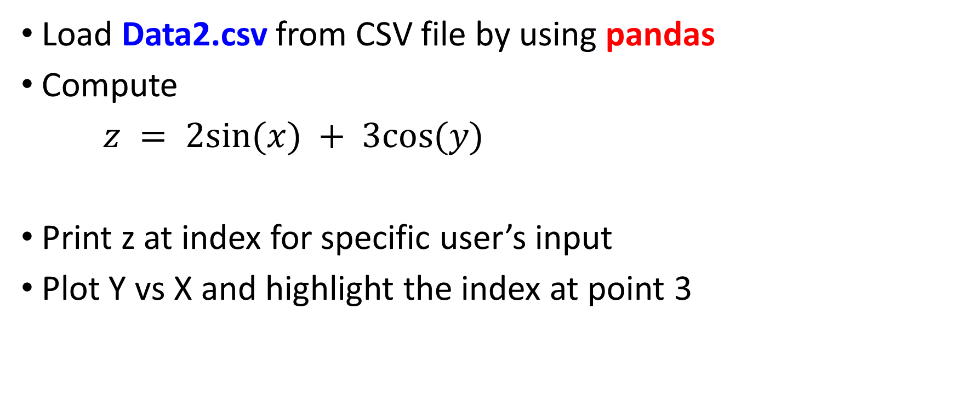
Exercise 2
Load Data2.csv from CSV file by using pandas
Compute
$z = 2sin⁡(x) + 3cos⁡(y)$
Print z at index for specific user’s input
Plot Y vs X and highlight the index at point 3

Slide 11
Optimization & Root Finding
Library
NumPy and SciPy were created to do numerical and scientific computing in the most natural way with Python.
SciPy - provides many user-friendly and efficient numerical routines such as routines for numerical integration, interpolation, optimization, linear algebra and statistics.
Root Finding
Optimisation

Slide 12






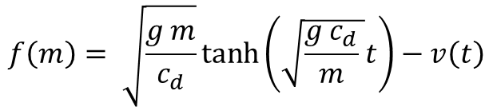
1. Root Finding
A simple method for obtaining an estimate of the root of the equation $f(x) = 0$ is to make a plot of the function and observe where it crosses the x axis.
This point, which represents the x value for which f (x) = 0, provides a rough approximation of the root.
Let:
$$f\left(m\right)= \sqrt{\frac{g m}{c_{d}}}\tanh\left(\sqrt{\frac{g c_{d}}{m} }t\right)−v\left(t\right)$$
$$f\left(x\right)=0, then x= ?$$

Slide 13

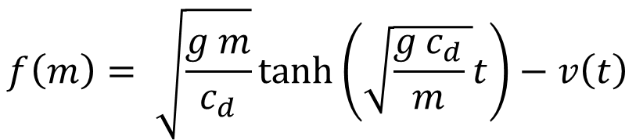
Exercise 3
Find root, $x$ for given function,
Given: $g=9.81,C_{d}=0.25, t=4, v=36$
$$f\left(m\right)= \sqrt{\frac{g m}{c_{d}}}\tanh\left(\sqrt{\frac{g c_{d}}{m} }t\right)−v\left(t\right)$$

Slide 14
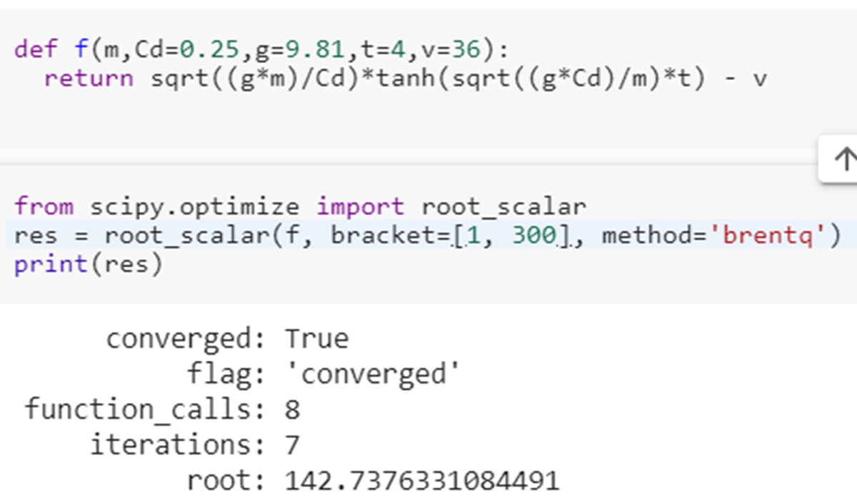



Exercise 3
Find root, $x$ for given function,
Given: $g=9.81,C_{d}=0.25, t=4, v=36$
$$f\left(m\right)= \sqrt{\frac{g m}{c_{d}}}\tanh\left(\sqrt{\frac{g c_{d}}{m} }t\right)−v\left(t\right)$$

Slide 15
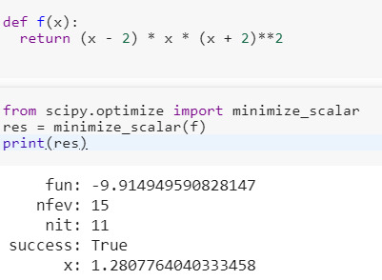


2. Scalar Optimisation
Let:
$f\left(x\right)=x\left(x−2\right){\left(x+2\right)}^{2}$
Find $x$ for $\min_{x}{f(x)}$
Method:
Step 1: Define function.
Step 2: Use minimize_scalar fcn.

Slide 16
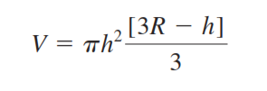
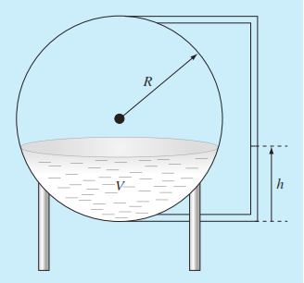
Answer on the following
Q1. The following data were gathered to determine the relationship between pressure and temperature of a fixed volume of 1 kg of nitrogen. The volume is 10 m³. Employ the ideal gas law pV = nRT to determine R, based on data (dataQ1.csv). Note that for the law, T must be expressed in kelvins.
Q2. You are designing a spherical tank to hold water for a small village in a developing country. The volume of liquid it can hold can be computed as
where V = volume (m3), h = depth of water in tank (m), and
R = the tank radius (m).
Determine depth of the tank for Volume of 30 m³ and R = 3 m.

Slide 17
End

